Slide 1
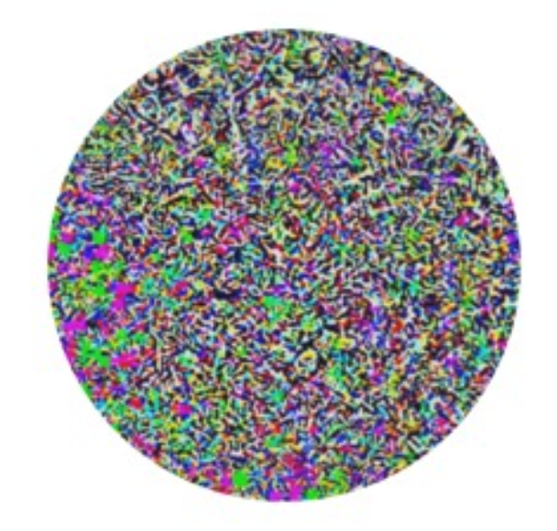
Adversarial Examples
姜育刚，马兴军，吴祖煊

Slide 2
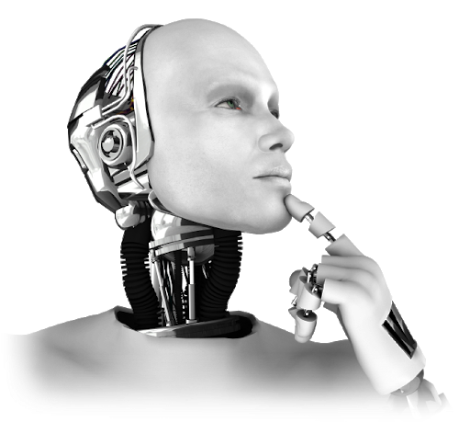
Recap: week 2
1. Deep Neural Networks
2. Explainable Machine Learning
Principles and Methodologies
Learning Dynamics
The Learned Model
Inference
Generalization
Robustness to Common Corruptions

Slide 3
This Week
1. Adversarial Examples
2. Adversarial Attacks
3. Adversarial Vulnerability Understanding

Slide 4
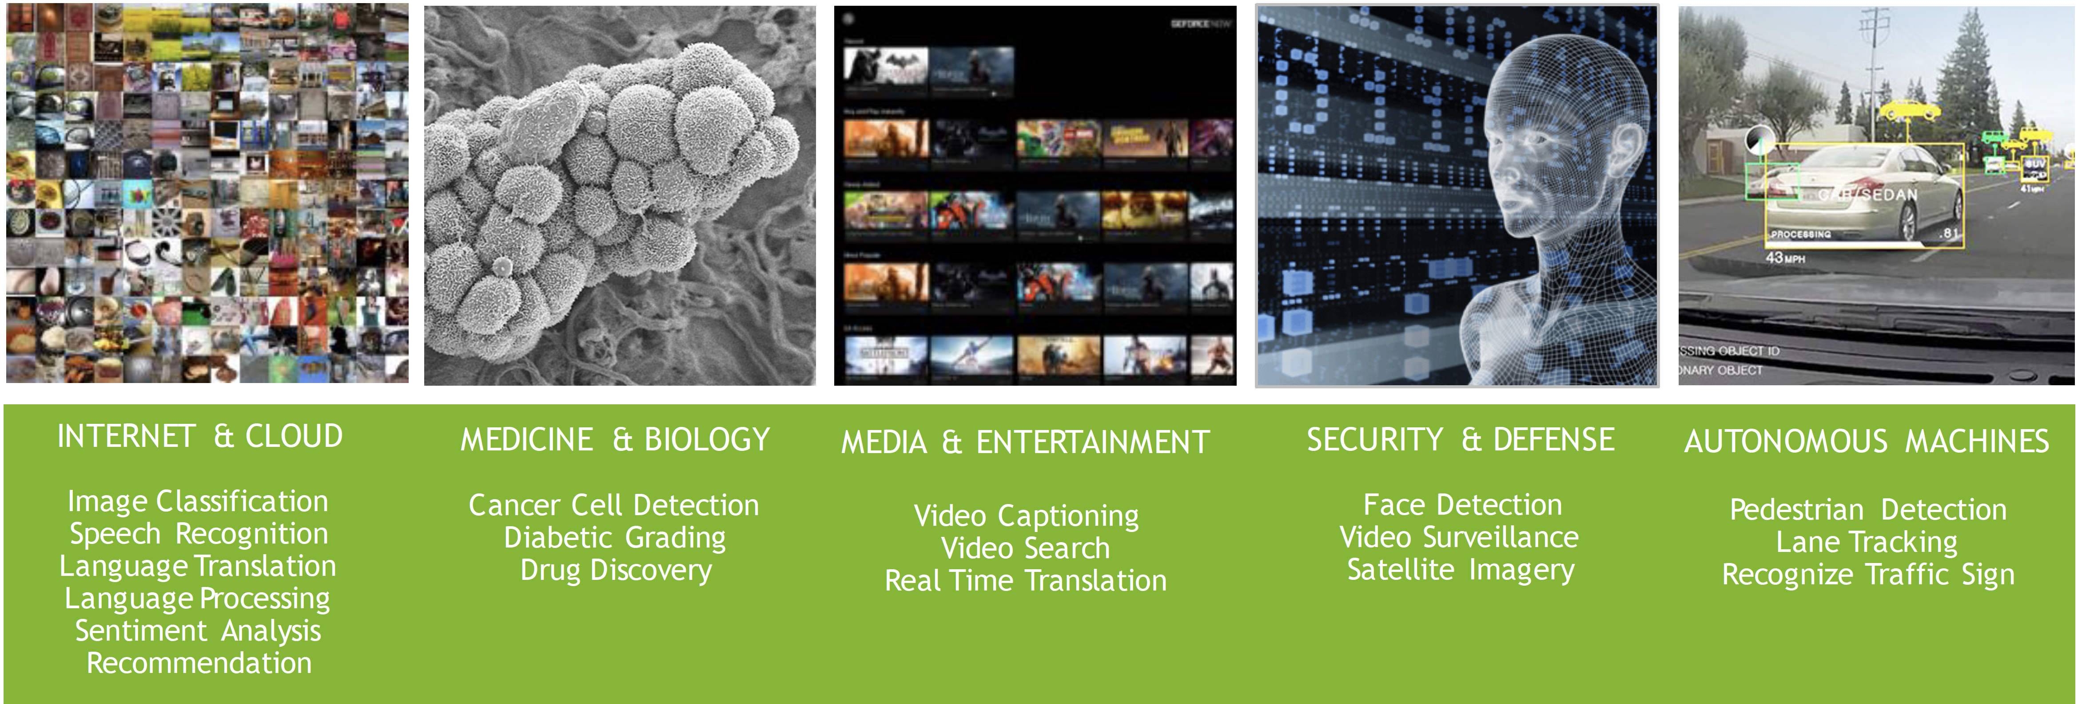
Machine Learning Is Everywhere
Security and Defense
Financial System
IoT
Machine Learning
Medicine and Biology
Autonomous Vehicle
Critical Infrastructure
Media and Entertainment

Slide 5
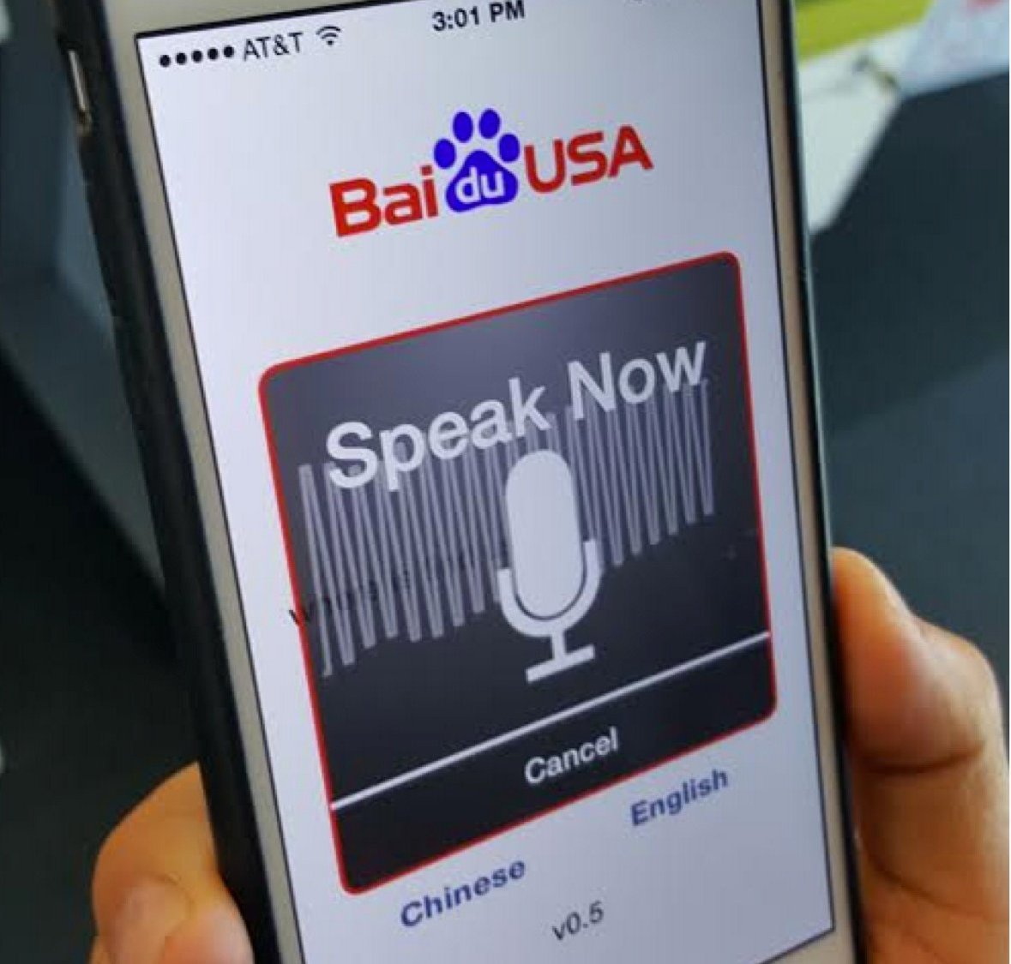
Beat Humans on Many Tasks
Speech Recognition
Baidu Deep Speech 2:
End-to-end Deep Learning for English and Mandarin Speech Recognition
English and Mandarin speech recognition Transition from English to Mandarin made simpler by end-to-end DL
No feature engineering or Mandarin-specifics required
More accurate than humans
Error rate 3.7% vs. 4% for human tests
http://svail.github.io/mandarin/
https://arxiv.org/pdf/1512.02595.pdf

Slide 6
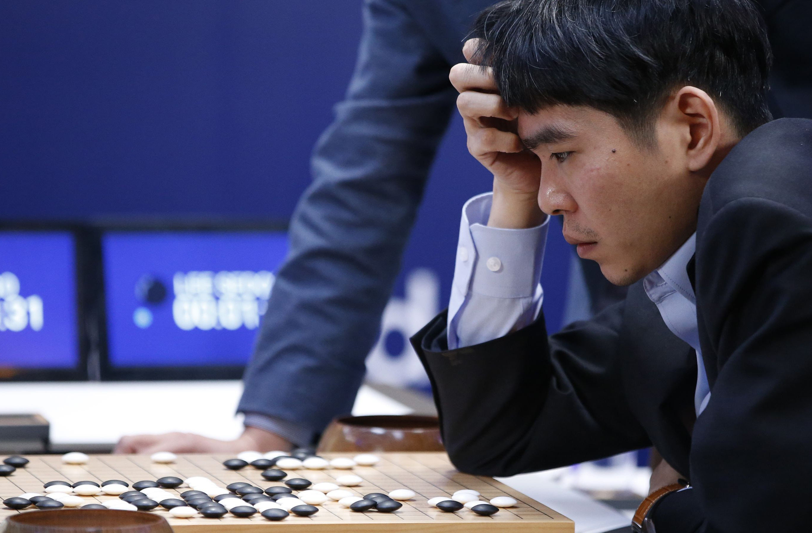
Outperform Human on Many Tasks
Strategic Games
AlphaGo:
First Computer Program to Beat a Human
Go Professional
Training DNNs: 3 weeks, 340 million training steps on 50 GPUs
Play: Asynchronous multi-threaded search
Simulations on CPUs, policy and value DNNs in parallel on GPUs
Single machine: 40 search threads, 48 CPUs, and 8 GPUs
Distributed version: 40 search threads, 1202 CPUs and 176 GPUs
Outcome: Beat both European and World Go champions in best of 5 matches
http://www.nature.com/nature/journal/v529/n7587/full/nature16961.html

Slide 7
Outperform Human on Many Tasks
Strategic Games
AlphaGo:
First Computer Program to Beat a Human
Go Professional
Training DNNs: 3 weeks, 340 million training steps on 50 GPUs
Play: Asynchronous multi-threaded search
Simulations on CPUs, policy and value DNNs in parallel on GPUs
Single machine: 40 search threads, 48 CPUs, and 8 GPUs
Distributed version: 40 search threads, 1202 CPUs and 176 GPUs
Outcome: Beat both European and World Go champions in best of 5 matches
http://www.nature.com/nature/journal/v529/n7587/full/nature16961.html

Slide 8

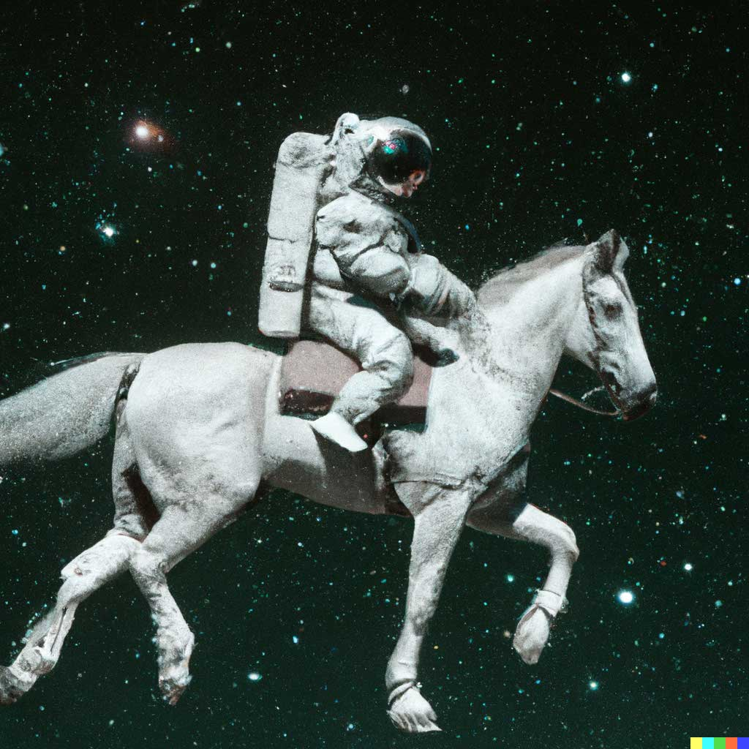
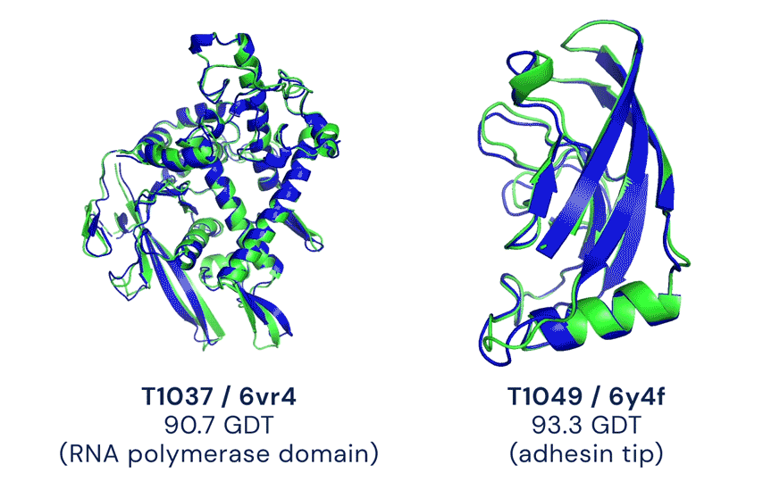
Outperform Human on Many Tasks
Large-scale Image Recognition
DALL·E 2
AlphaFold V2

Slide 9
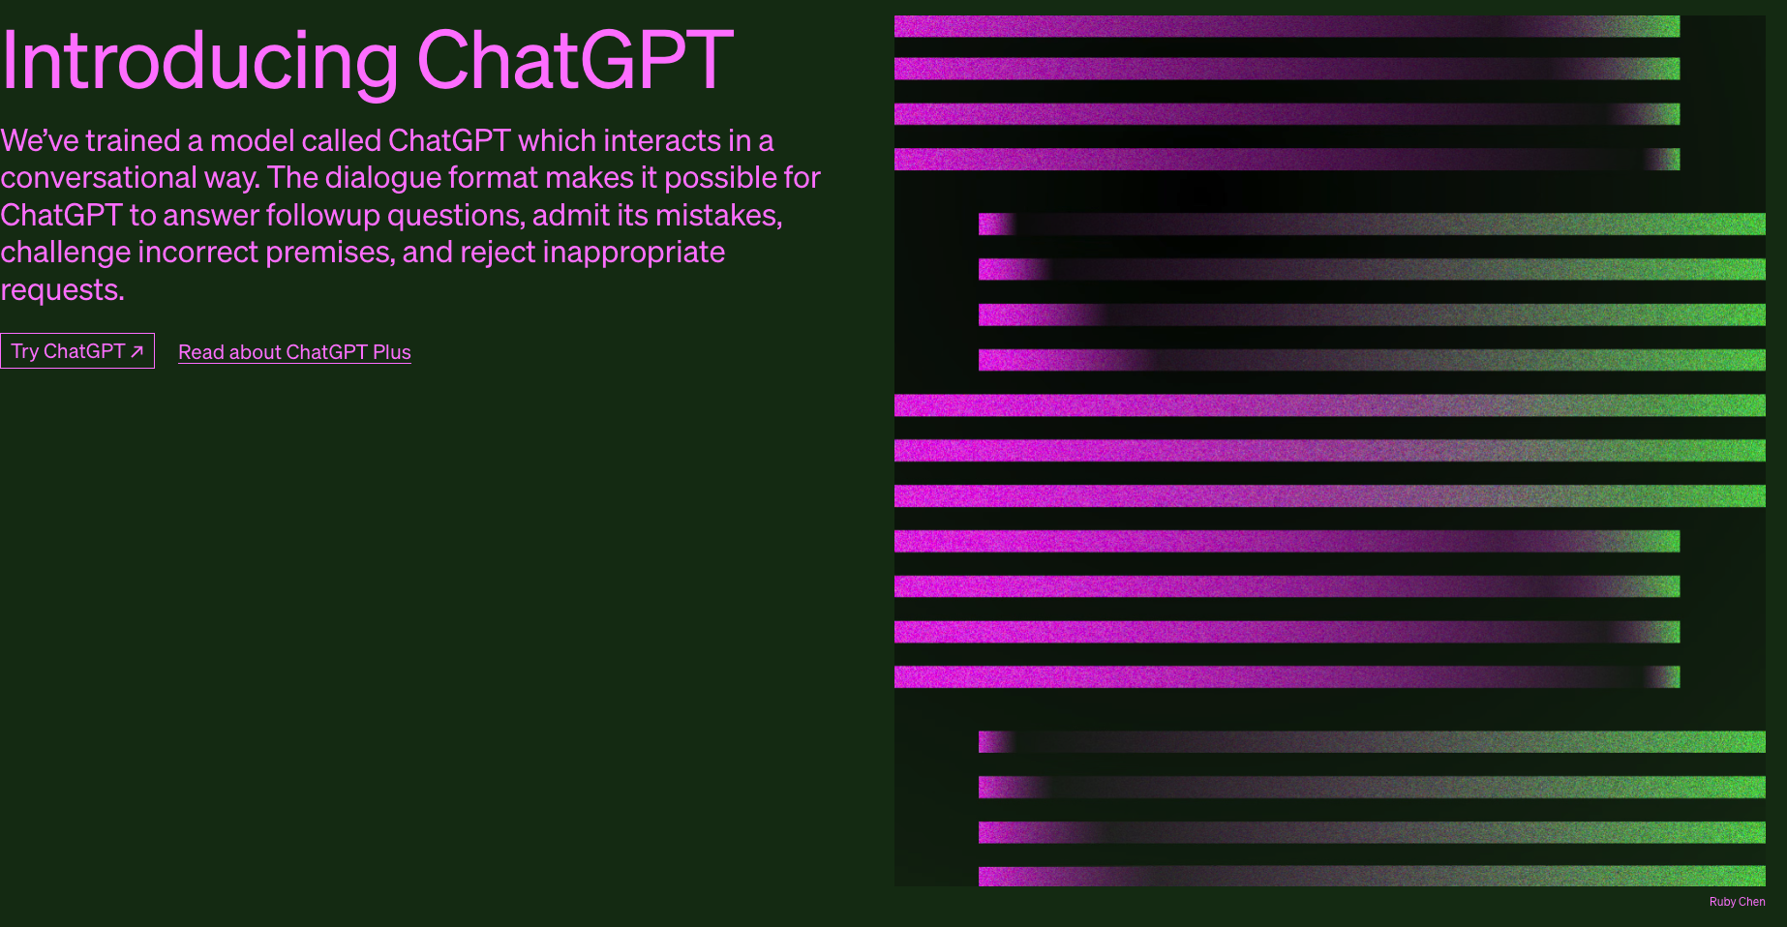
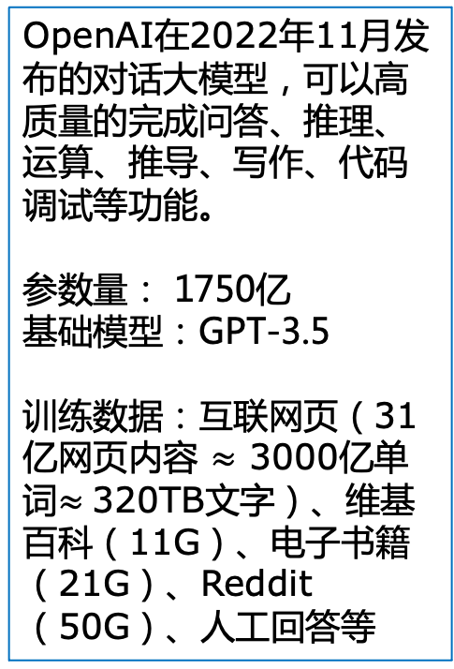
Large Language Model (LLM): ChatGPT
OpenAI在2022年11月发布的对话大模型，可以高质量的完成问答、推理、运算、推导、写作、代码调试等功能。
参数量： 1750亿
基础模型：GPT-3.5
训练数据：互联网页（31亿网页内容 $≈$ 3000亿单词$≈$320TB文字）、维基百科（11G）、电子书籍（21G）、Reddit（50G）、人工回答等

Slide 10
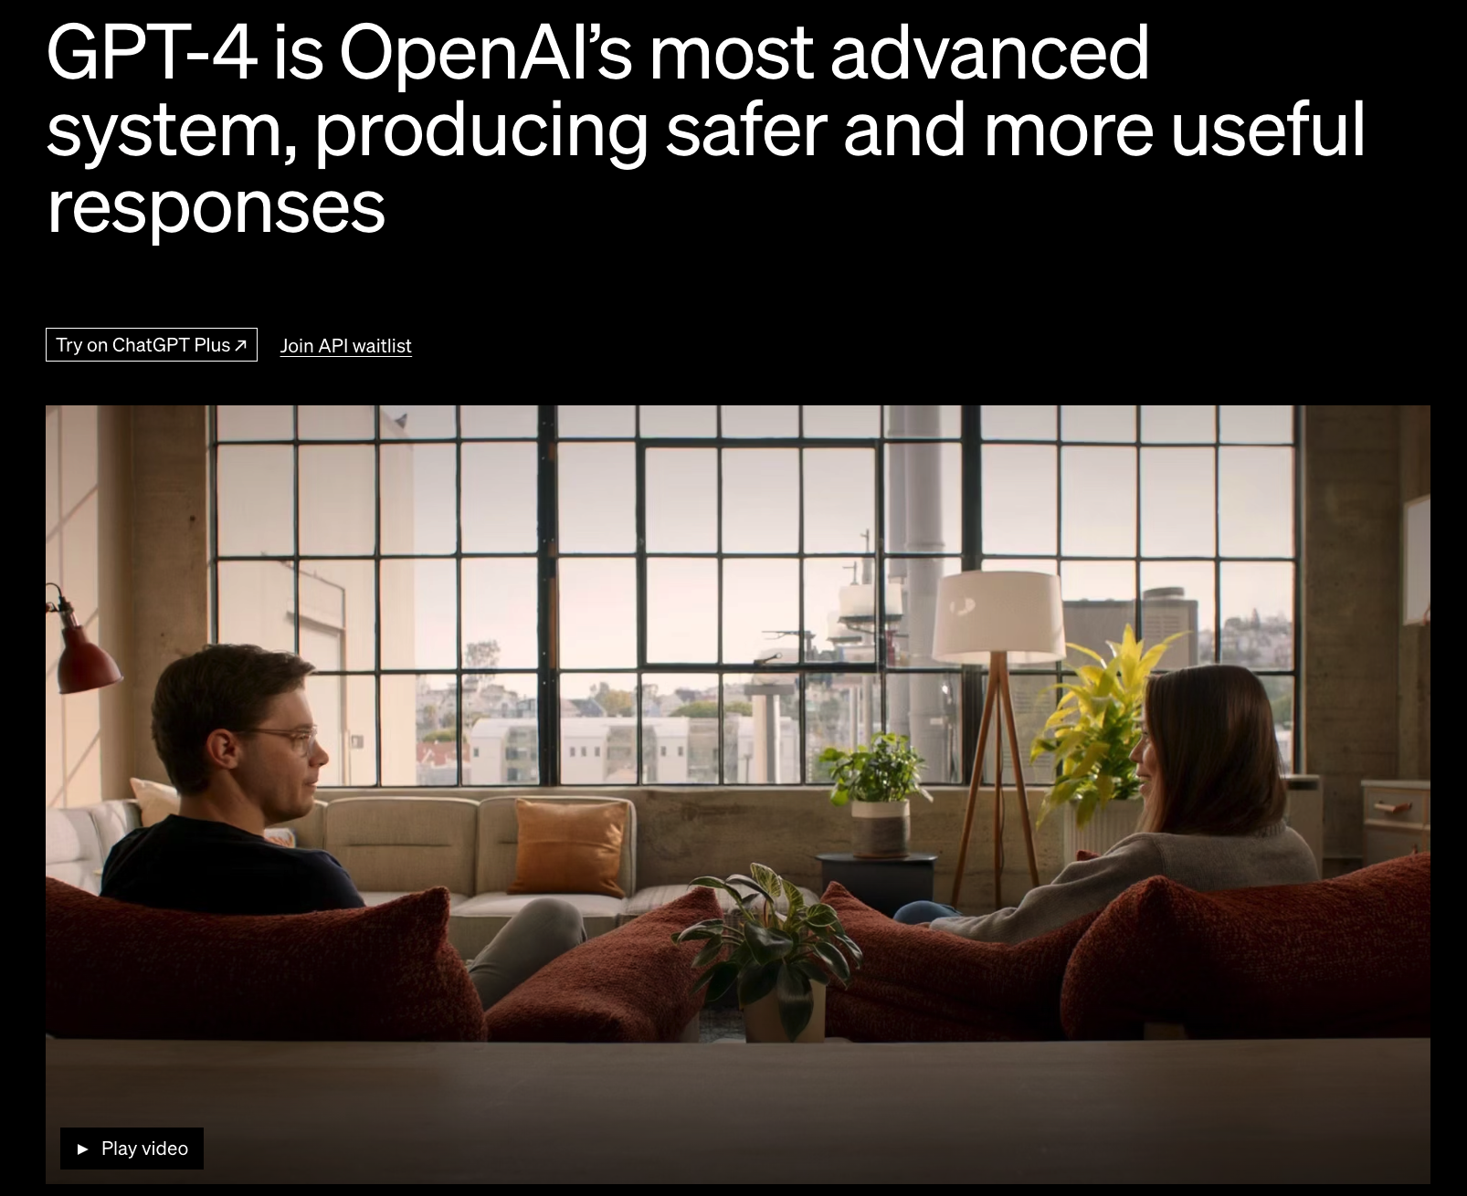
Large Multimodel Model: GPT-4
OpenAI在2023年3月发布的多模态对话大模型，能够接受图像和文本输入，并输出文本，具有超出ChatGPT的图文理解能力、运算能力、代码生成能力、以及很多专业考试能力。
参数量： 1万亿
基础模型：GPT-4
训练数据： 在GPT-3.5 、ChatGPT基础之上增加了多模态数据、更多的人工标注数据等等

Slide 11
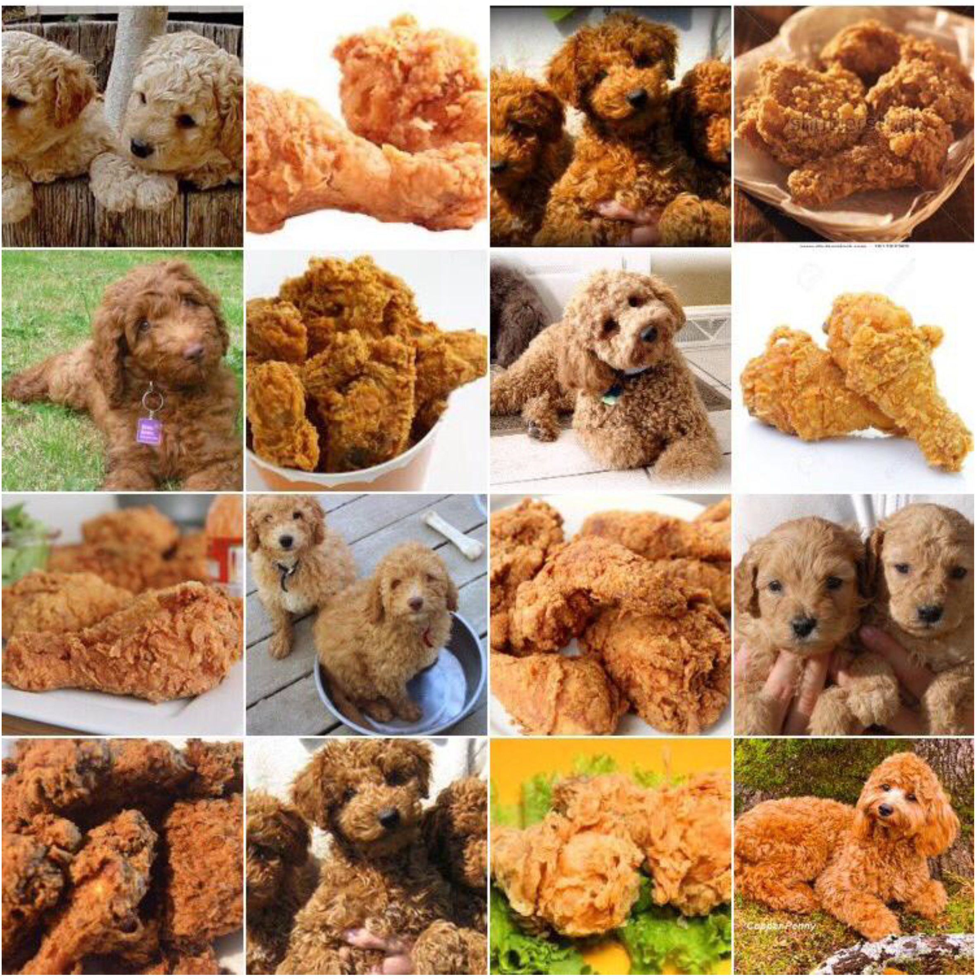
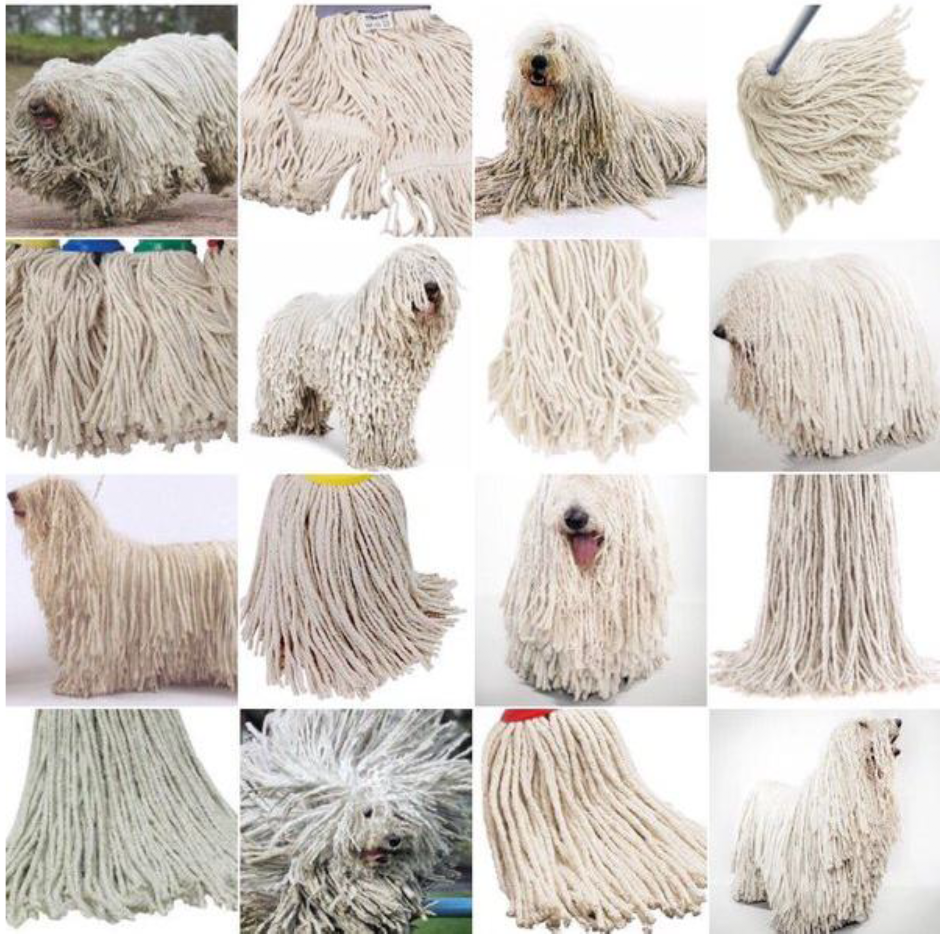
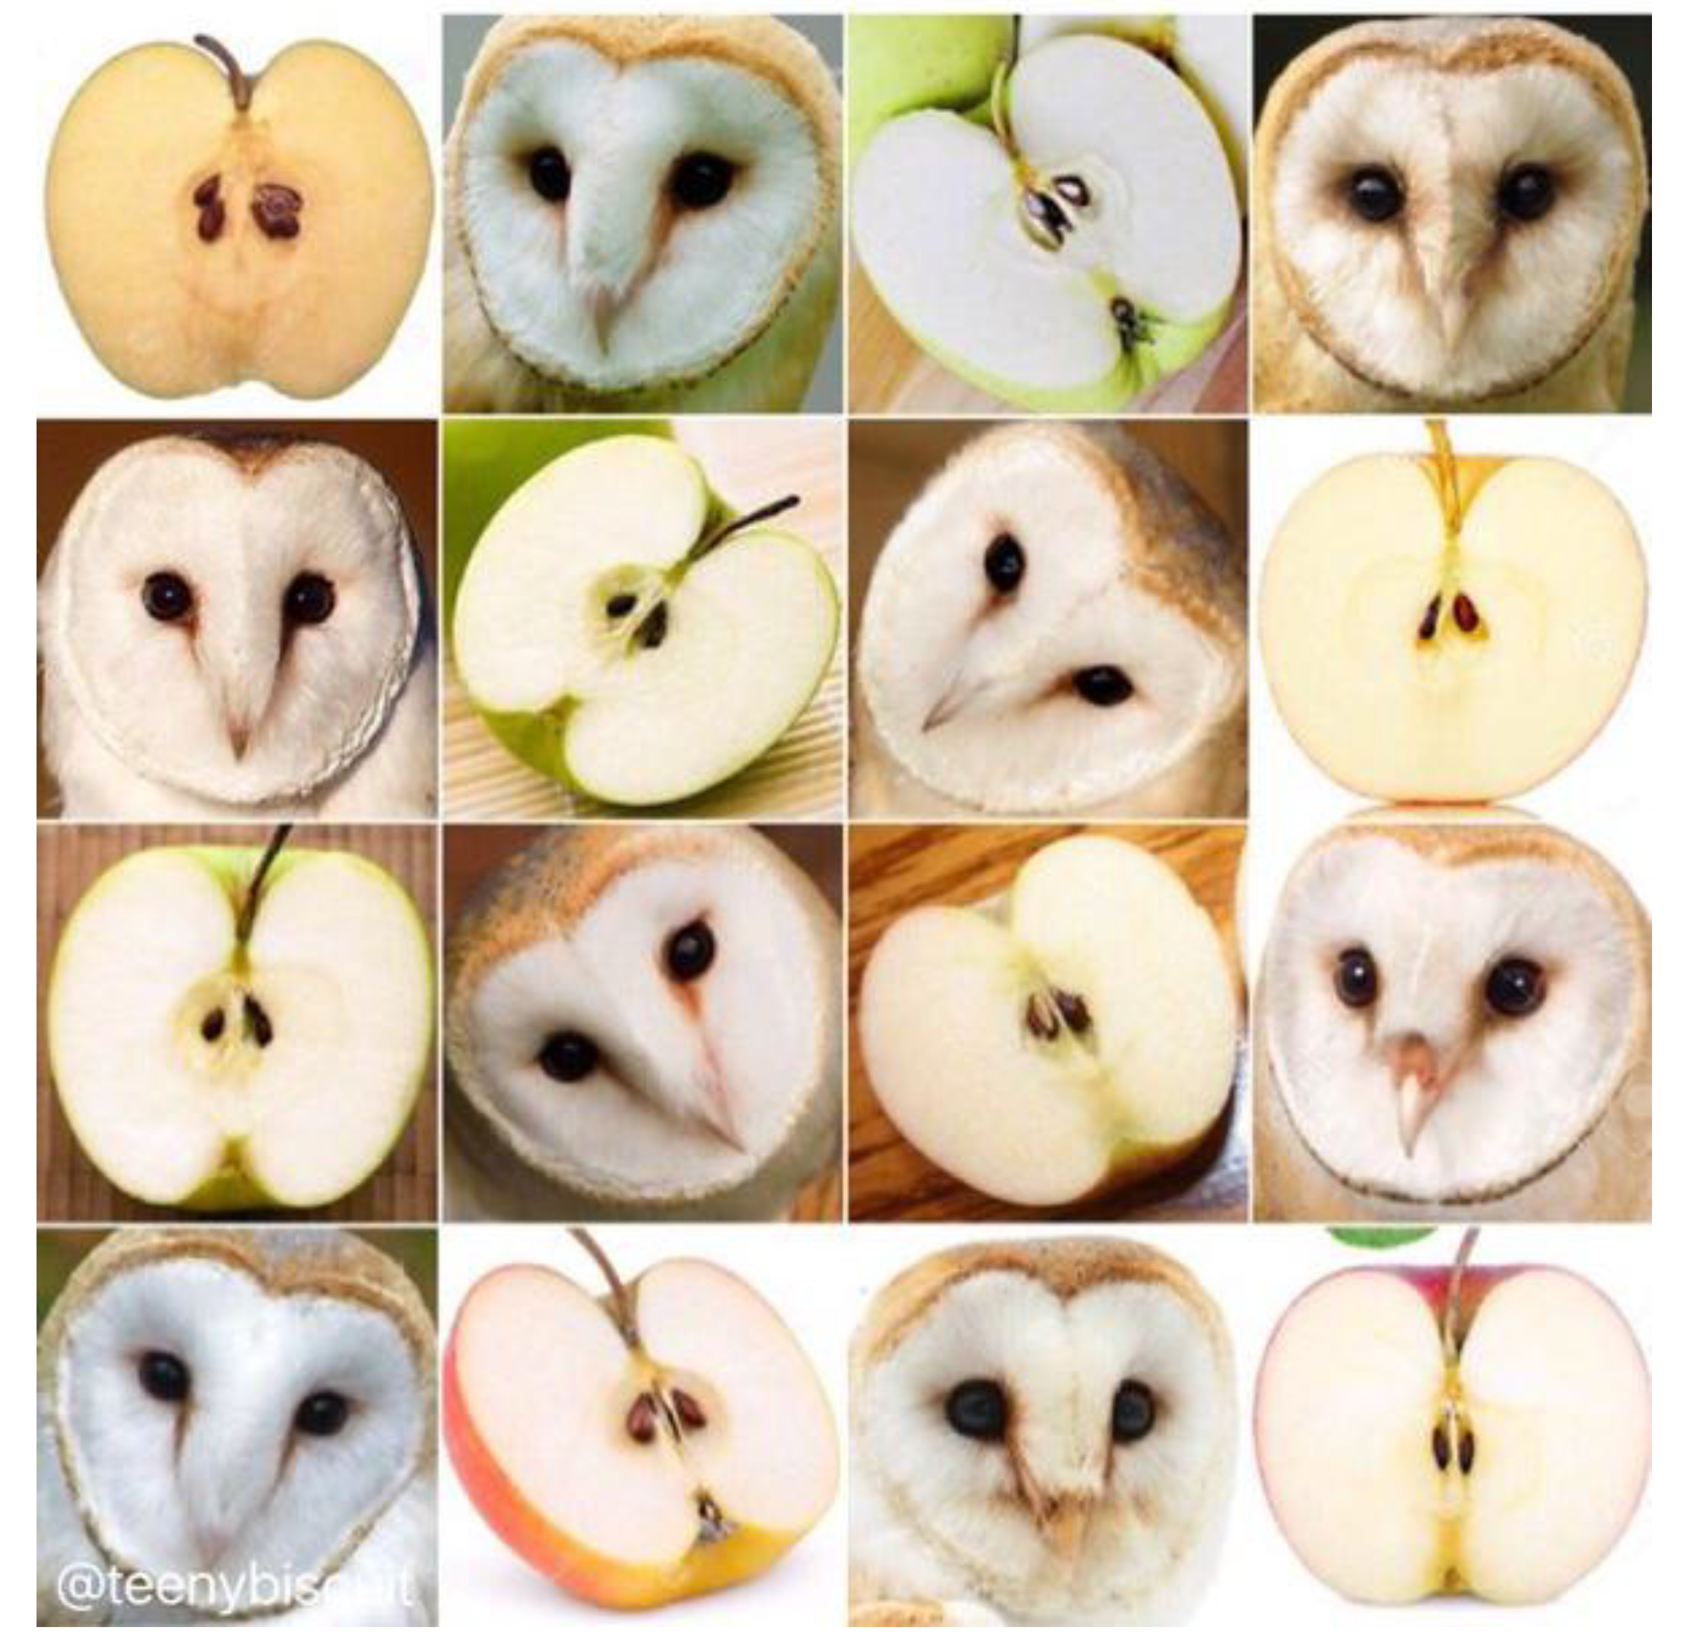
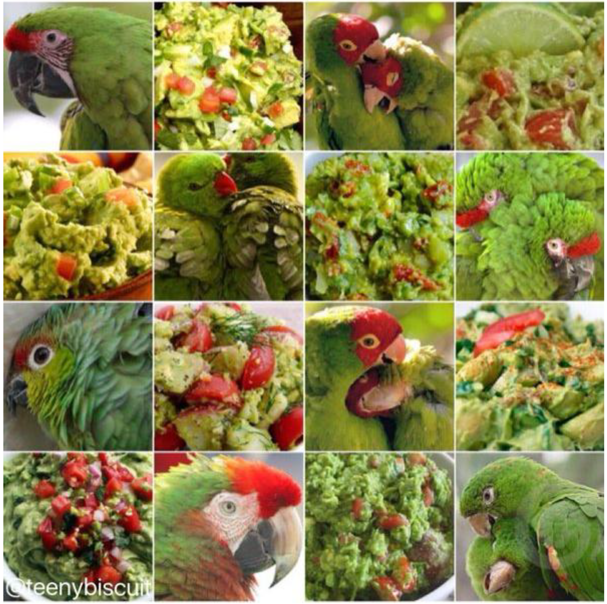
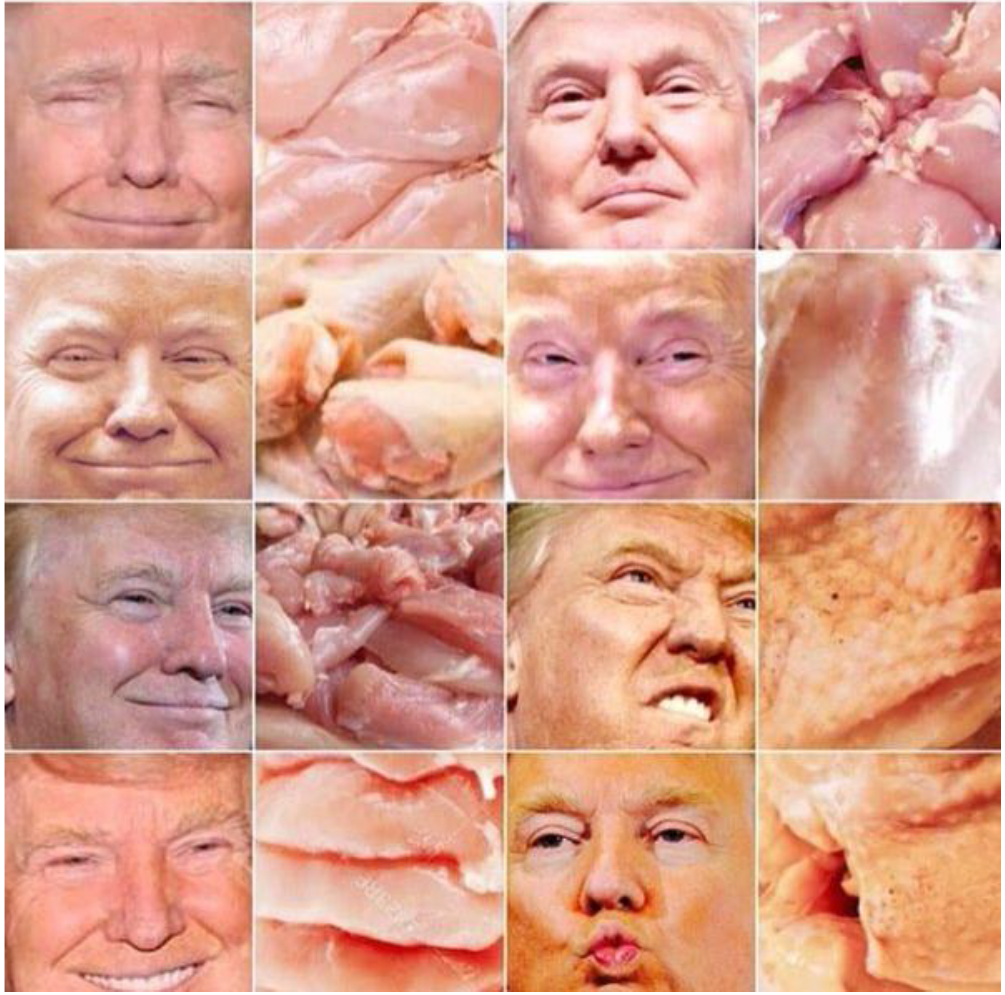
Outperform Human on Many Tasks
Image Recognition
GoogLeNet: http://cs.stanford.edu/people/karpathy/ilsvrc/
Sheepdog or Mop
Barn owl or Apple
Labrapoodle or Fried chicken
Parrot or Guacamole
Raw chicken or Donald Trump

Slide 12
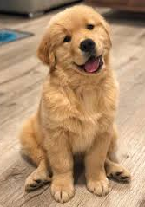
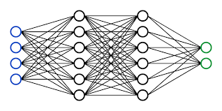
Vulnerabilities of DNNs
Dog,
82% confidence

Slide 13
Vulnerabilities of DNNs
Dog,
82% confidence
Ostrich,
98% confidence

Slide 14
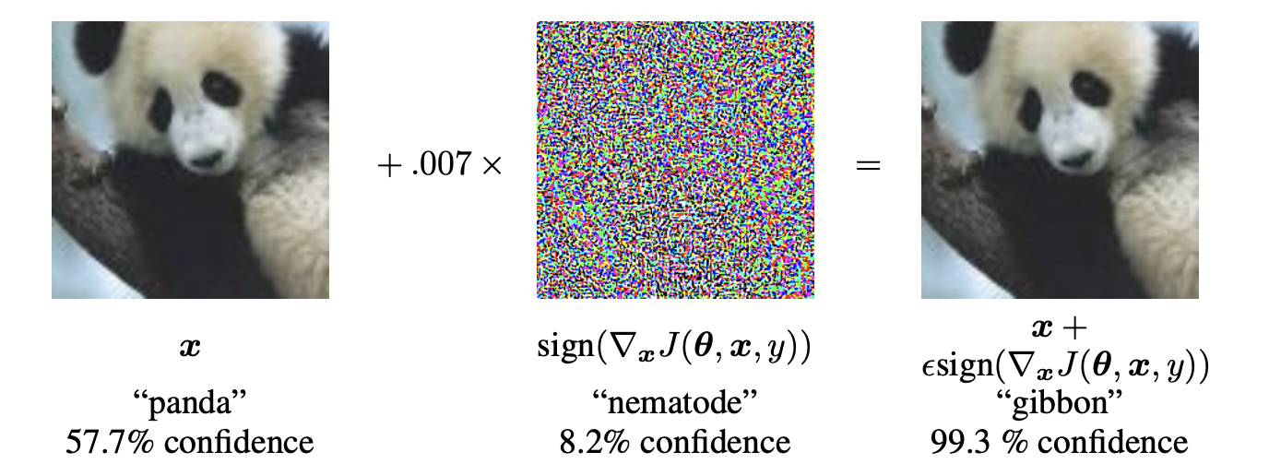
Adversarial Examples
Small perturbations can fool DNNs
Szegedy C, Zaremba W, Sutskever I, et al. Intriguing properties of neural networks[J]. ICLR 2014.
Goodfellow I J, Shlens J, Szegedy C. Explaining and harnessing adversarial examples[J]. ICLR 2015.

Slide 15
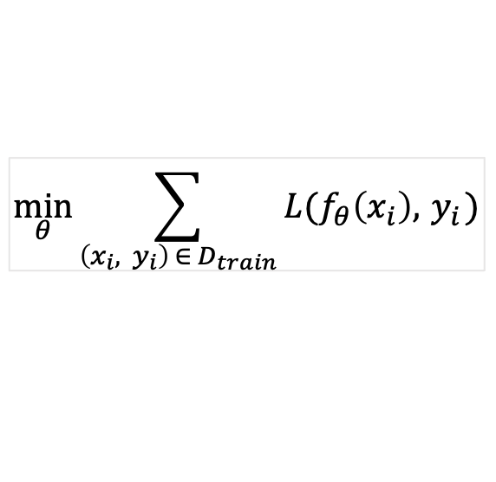
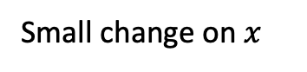
Adversarial Attack
$$\min_{θ}{\sum_{\left(x_{i}, y_{i}\right) ∈{ D}_{train}}{L(f_{θ}\left(x_{i}\right), { y}_{i})}}$$
DNN Training:
Adversarial Attack:
$$\max_{x^{′}}{L(f_{θ}\left(x^{′}\right),y)} subject to {\left\|x^{′}−x\right\|}_{p}≤ε for x∈D_{test}$$
Misclassification
Small change on $x$
test time attack
Small perturbation: ${\left\|x^{′}−x\right\|}_{p=1, 2 or\text{ ∞}}$, for example, ${\left\|⋅\right\|}_{\text{∞}}≤\frac{8}{255}$
Szegedy C, Zaremba W, Sutskever I, et al. Intriguing properties of neural networks[J]. ICLR 2014.
Goodfellow I J, Shlens J, Szegedy C. Explaining and harnessing adversarial examples[J]. ICLR 2015.

Slide 16
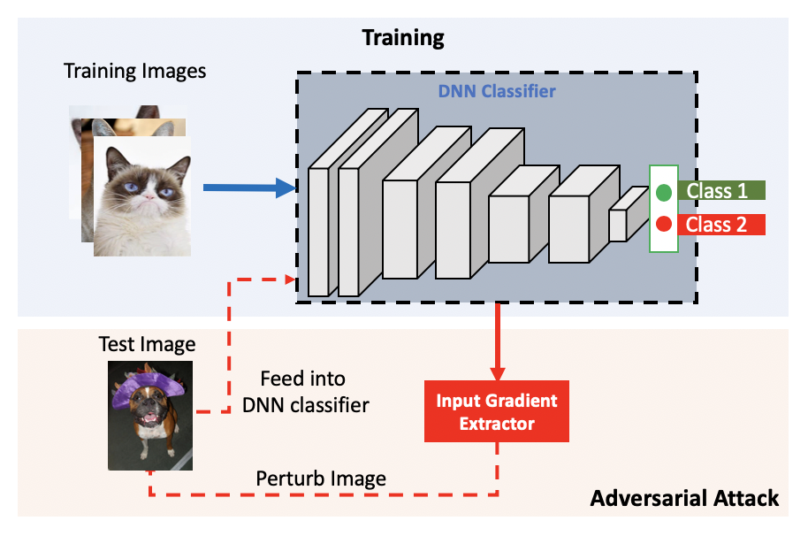
Adversarial Attack
1
2
3

Slide 17
Characteristics of Adversarial Examples
Adversarial Examples
Small
Imperceptible
Hidden
Transfer
Universal

Slide 18
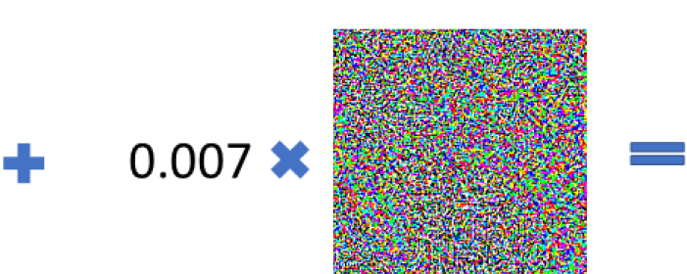
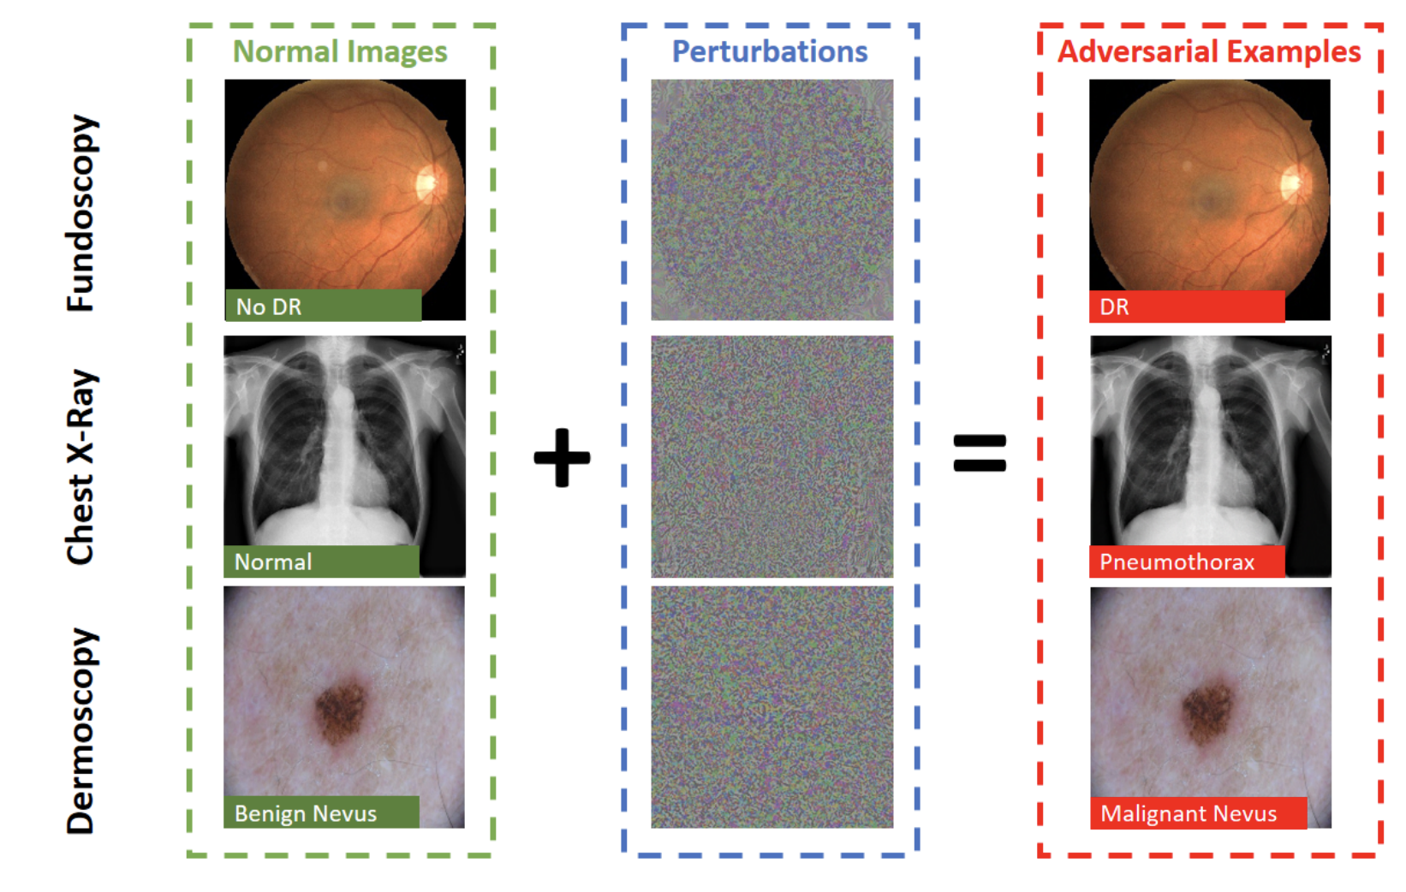
Example Attacks
Benign Nevus,
73% confidence
Adversarial noise
Malignant Nevus,
89% confidence
Perturbations are small, imperceptible to human eyes.
Adversarial examples are easy to generate and transfer across models.
Ma et al., “Understanding Adversarial Attacks on Deep Learning Based Medical Image Analysis Systems”, Pattern Recognition, 2021.

Slide 19
Example Attacks
Clean video frames: Correct Class
Adversarial video: Wrong Class
Jiang et al., “Black-box Adversarial Attacks on Video Recognition Models”, ACMMM, 2019.

Slide 20
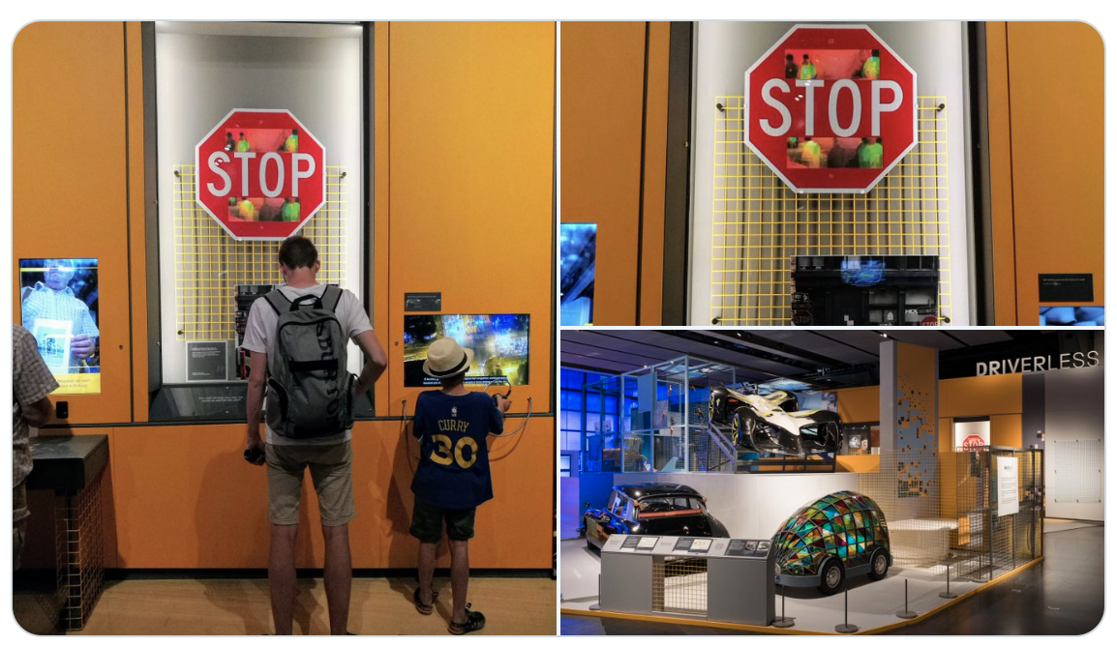
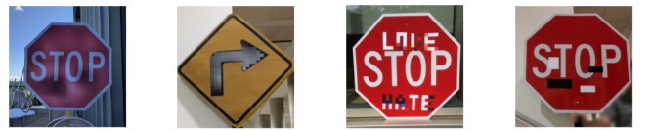
Example Attacks
Physical-world attacks against traffic signs
Stop signs recognized as 45km speed limit
Science Museum at London
Eykholt, Kevin, et al. “Robust physical-world attacks on deep learning visual classification.” CVPR, 2018.

Slide 21
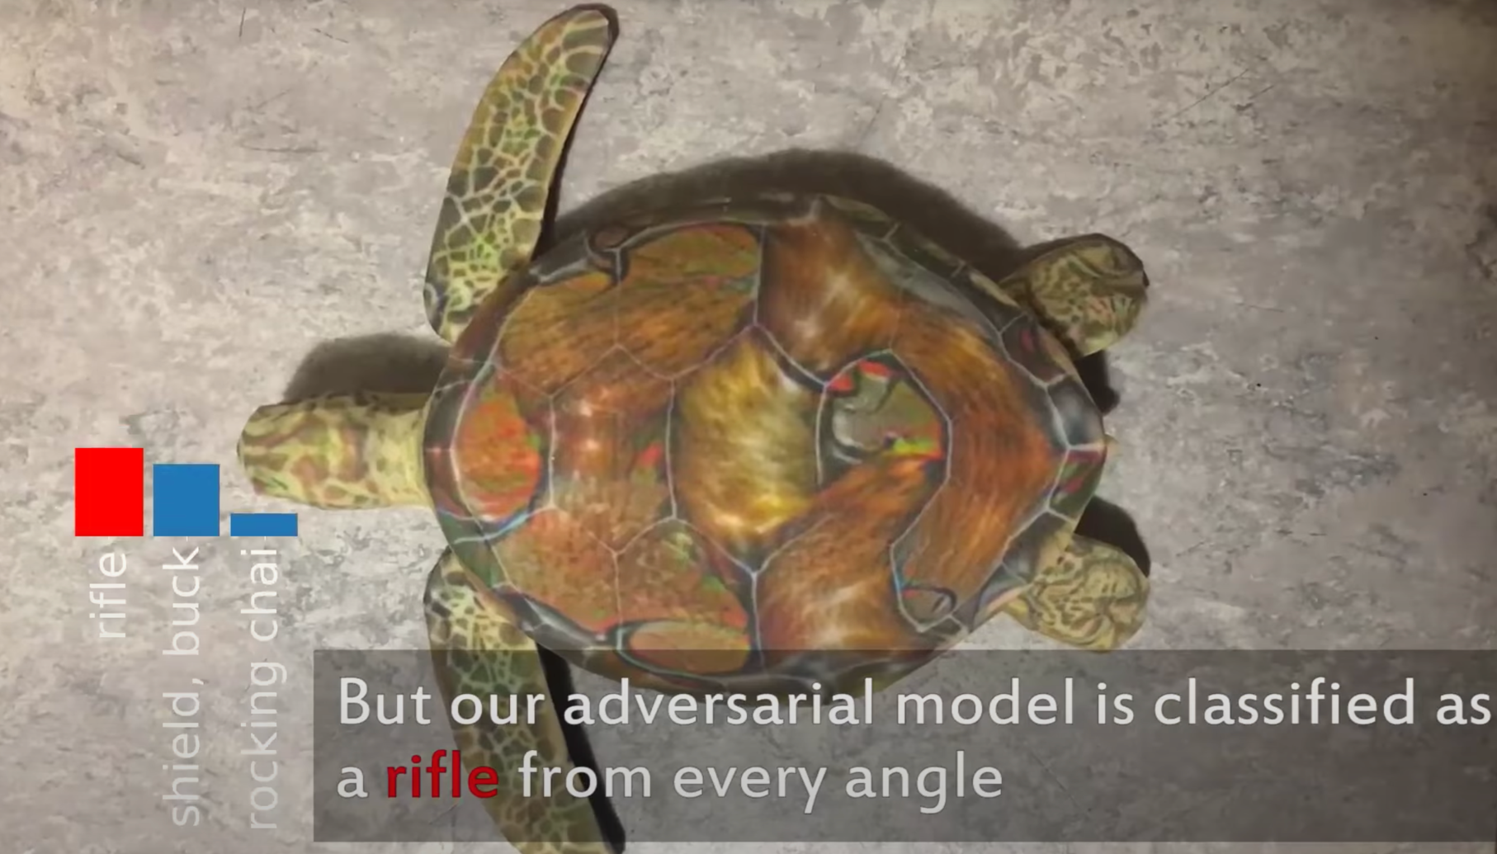
Example Attacks
3D printed turtle recognized as a rifle from any angle
Athalye, Anish, et al. "Synthesizing robust adversarial examples." ICML, 2018.

Slide 22
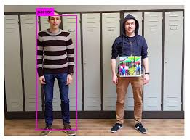
Example Attacks
Adversarial patch makes people invisible to object detection (YOLO)
Brown, Tom B., et al. "Adversarial patch." arXiv preprint arXiv:1712.09665 (2017).

Slide 23
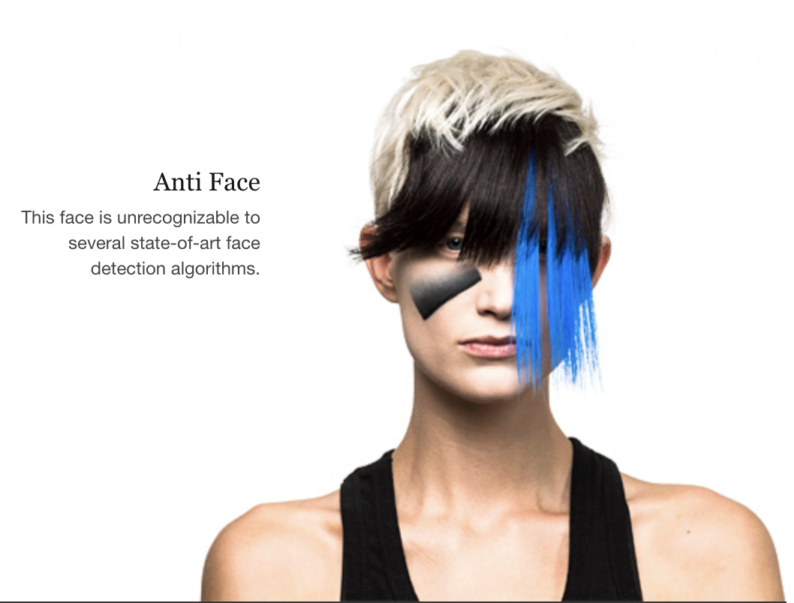
Example Attacks
https://cvdazzle.com/
Adversarial attack or new fashion?

Slide 24
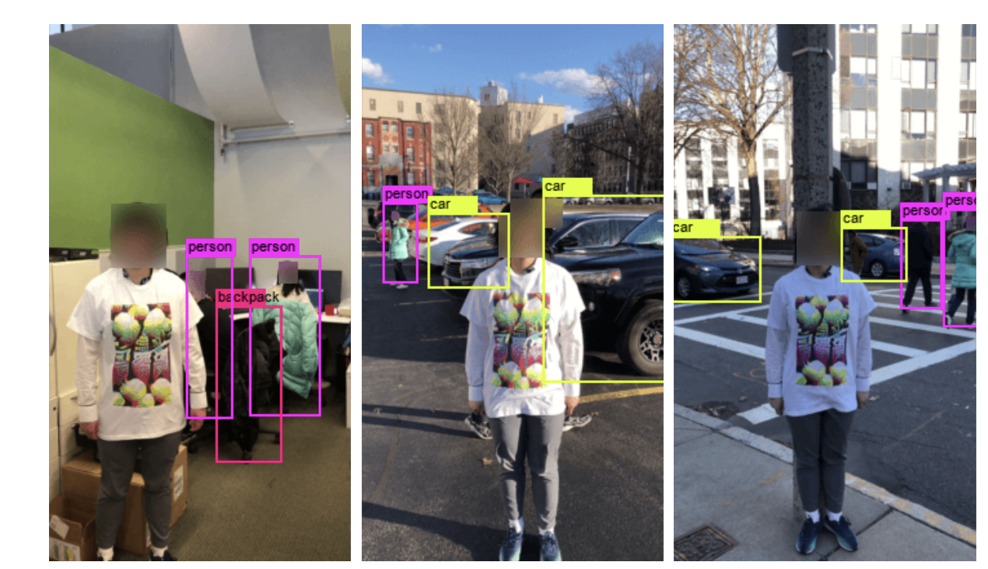
Example Attacks
Adversarial t-shirt: one step closer to real-world attack
Xu, Kaidi, et al. “Adversarial t-shirt! evading person detectors in a physical world.” ECCV, 2020.

Slide 25
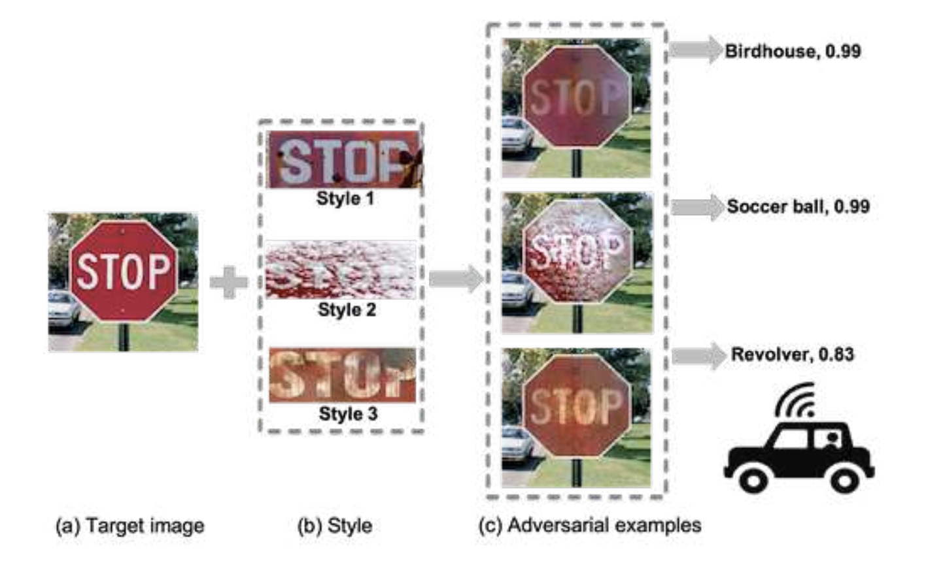
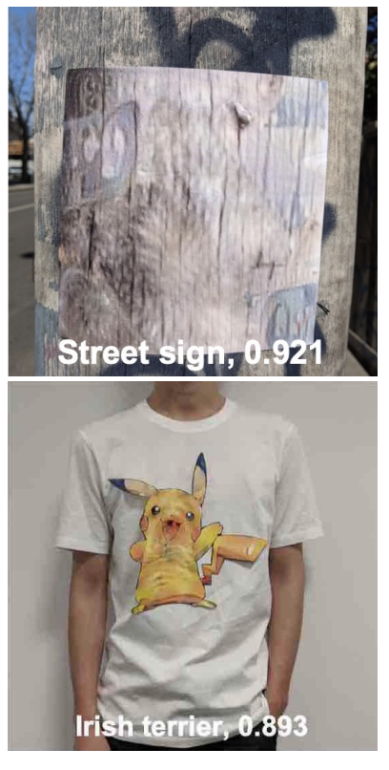
Example Attacks
Tree bark -> street sign
people+pikachu t-shirt -> dog
Camouflage adversarial patterns into realistic styles
Duan et al. Adversarial Camouflage: Hiding Physical-World Attacks With Natural Styles. CVPR, 2020.

Slide 26
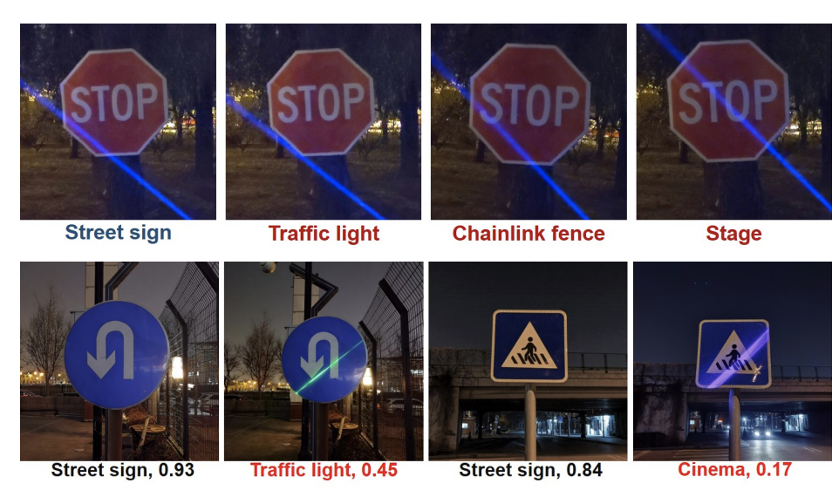
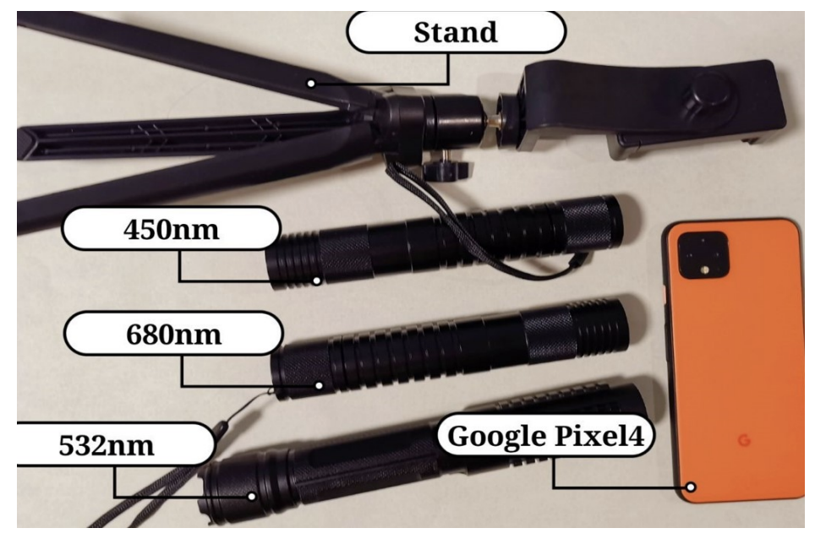
Example Attacks
Night scene adversarial attack with laser pointer
Duan, Ranjie, et al. "Adversarial laser beam: Effective physical-world attack to dnns in a blink." CVPR, 2021

Slide 27
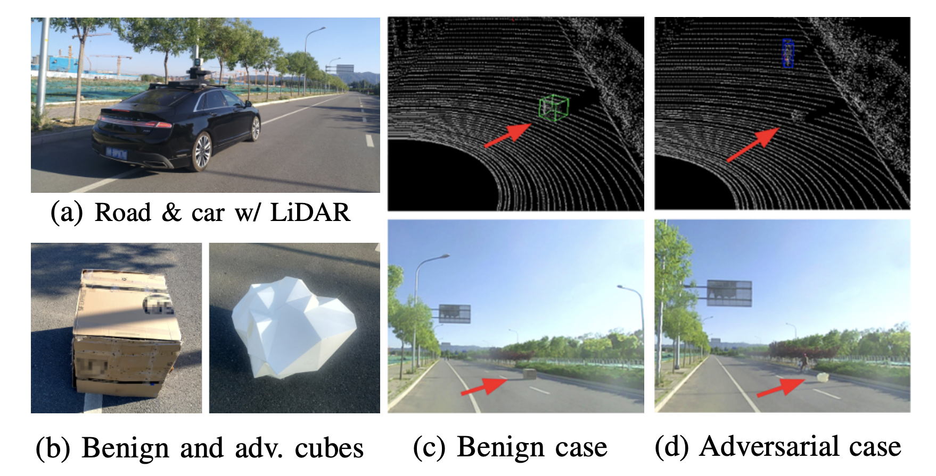
Example Attacks
Attacking both camera and lidar using adversarial objects
Cao, Yulong, et al. "Invisible for both camera and lidar: Security of multi-sensor fusion based perception in autonomous driving under physical-world attacks." S&P, 2021.

Slide 28
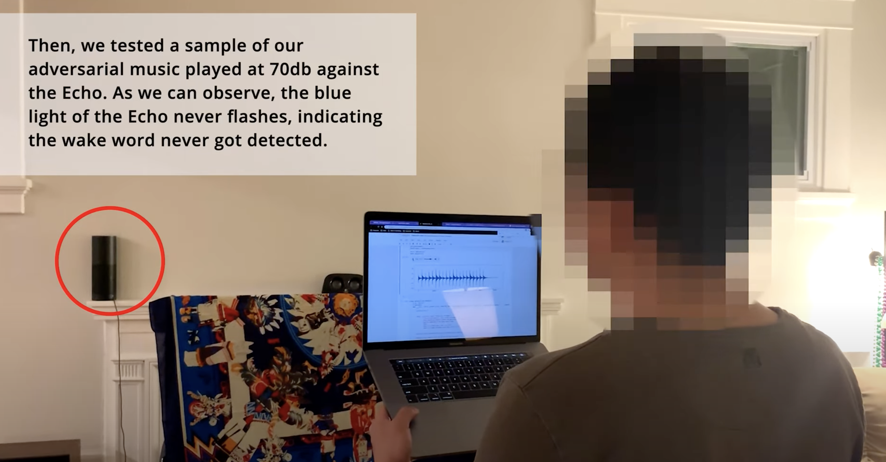
Example Attacks
Attacking speech/command recognition models
Carlini, Nicholas, and David Wagner. “Audio adversarial examples: Targeted attacks on speech-to-text.” S&PW, 2018.
https://nicholas.carlini.com/code/audio_adversarial_examples/
Adversarial Music: Real world Audio Adversary against Wake-word Detection System
https://www.youtube.com/watch?v=r4XXGDVs0f8

Slide 29
Example Attacks
Q&A Adversaries
Ribeiro et al. “Semantically equivalent adversarial rules for debugging NLP models.” ACL, 2018.

Slide 30
Threats to AI Applications
Transportation industry
Trick autonomous vehicles into misinterpreting stop signs or speed limit
Cybersecurity industry
Bypass AI-based malware detection tools
Medical industry
Forge medical condition
Smart Home industry
Fool voice commands
Financial Industry
Trick anomaly and fraud detection engines

Slide 31
Definition of Adversarial Examples
No standard community-accepted definition
“Adversarial examples are inputs to machine learning models that an attacker has intentionally designed to cause the model to make a mistake”
Goodfellow, Ian. “Defense against the dark arts: An overview of adversarial example security research and future research directions." arXiv:1806.04169 (2018).

Slide 32
Taxonomy of Attacks
Attack timing
Poisoning attack
Evasion attack
Attacker’s goal
Targeted attack
Untargeted attack
Attacker’s knowledge
Black-box
White-box
Gray-box
Universality
Individual
Universal

Slide 33
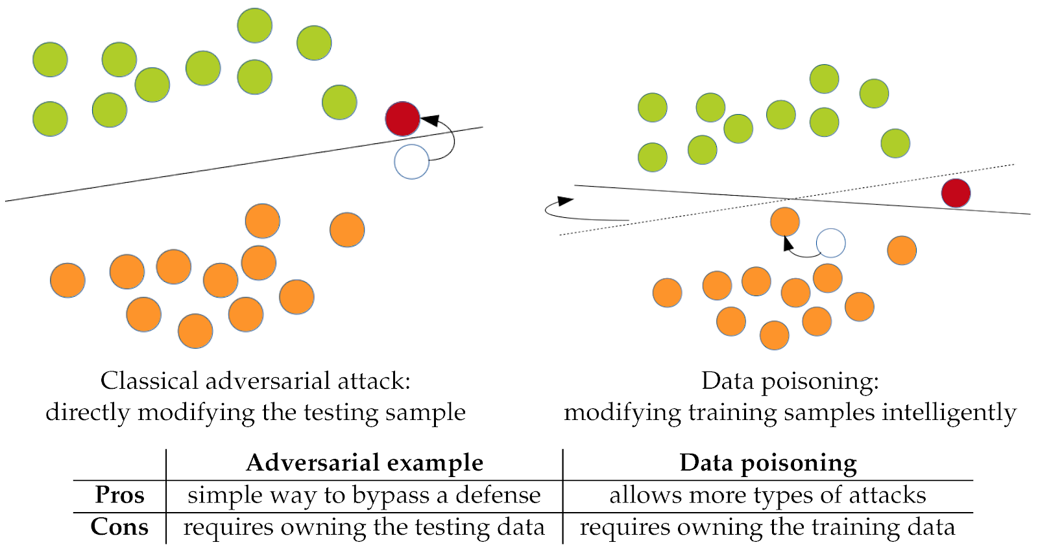
Attack Timing
Evasion (Causation) attack
Test time attack
Change input example
Poisoning attack
Training time attack
Change classification boundary

Slide 34
Attacker's Goal
Targeted attack
Cause an input to be recognized as coming from a specific class
Untargeted attack
Cause an input to be recognized as any incorrect class
Ostrich
Any class, except dog

Slide 35
Adversary's Knowledge
White-box attack:
Attacker has full access to the model, including model type, model architecture, values of parameters and training weights
Black-box attack:
Attacker has no knowledge about the model under attack
Rely on transferability of adversarial examples
Gray-box attack (Semi-black-box attack)
Attacker may know some hyperparameters like model architecture

Slide 36
Universality
Individual attack
Generate different perturbations for each clean input
Universal attack
Only create a universal perturbation for the whole dataset. Make it easier to deploy adversary examples.
Moosavi-Dezfooli, Seyed-Mohsen, et al. “Universal adversarial perturbations.” CVPR 2017.

Slide 37
A Brief History of Adversarial Machine Learning
2014年Goodfellow等人提出快速单步攻击FGSM及对抗训练
2018年物理世界攻击方法、检测方法升级、PGD攻击与对抗训练、9种防御方法被攻破
2020年AutoAttack攻击、Fast对抗训练
2022年尚未解决的问题，攻击越来越多，防御越来越难
2016年提出对抗训练的min-max优化框架
2013年Biggio等人与Szegedy等人发现对抗样本
2015年简单检测方法（PCA）和对抗训练方法
2017年大量的对抗样本检测方法和攻击方法（BIM、C&W）、10种检测方法被攻破
2019年TRADES及大量其他对抗训练方法、第一篇Science文章
2021年增大模型、增加数据的对抗训练、领域延伸
Biggio et al. “Evasion attacks against machine learning at test time.”; Szegedy, Christian, et al. "Intriguing properties of neural networks."

Slide 38
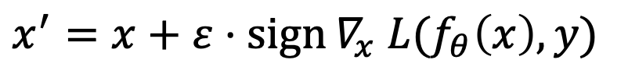
White-box Attacks
单步攻击：Fast Gradient Sign Method (FGSM) (Goodfellow et al. 2014):
$$x^{′}=x+ε⋅\operatorname{sign}{∇_{x} L(f_{θ}\left(x\right),y)}$$
多步攻击：Iterative Methods (BIM, PGD), (Kurakin et al. 2016; Madry et al. 2018):
$x_{t+1}^{′}={project}_{ε}\left(x_{t}^{′}+ α⋅\operatorname{sign}{∇_{x}L(f_{θ}\left(x_{t}^{′}\right),y)}\right)$, $α:\text{step} \text{size}$
Projected Gradient Descent (PGD): strongest first-order attack.
基于优化的攻击：C&W attack (Carlini & Wagner 2017): CW attack was the strongest attack
$\min_{x^{′}}{\left\|x^{′}−x\right\|}_{2}^{2}−c⋅{L\left(f_{θ}\left(x^{′}\right), y\right)}, c$: confidence, $y$: clean label
集成攻击：AutoAttack (Croce et al. 2020): current strongest attack

Slide 39

Why Adversarial Examples Exist?

Slide 40
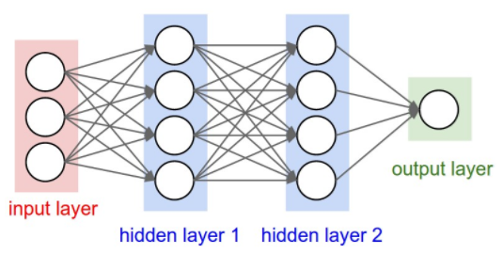
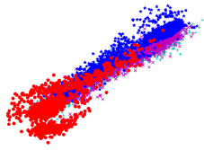
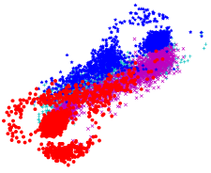
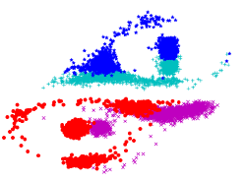
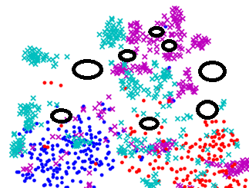
Non-linear Explanation
Viewing DNN as a sequence of transformed spaces:
1st layer
10th layer
20th layer
High dimensional non-linear explanation:
Non-linear transformations leads to the existence of small “pockets” in the deep space:
Regions of low probability (not naturally occurring).
Densely scattered regions.
Continuous regions.
Close to normal data subspace.
Szegedy C, Zaremba W, Sutskever I, et al. Intriguing properties of neural networks[J]. ICLR 2014; Ma et al. Characterizing Adversarial Subspace Using Local Intrinsic Dimensionality. ICLR 2018

Slide 41
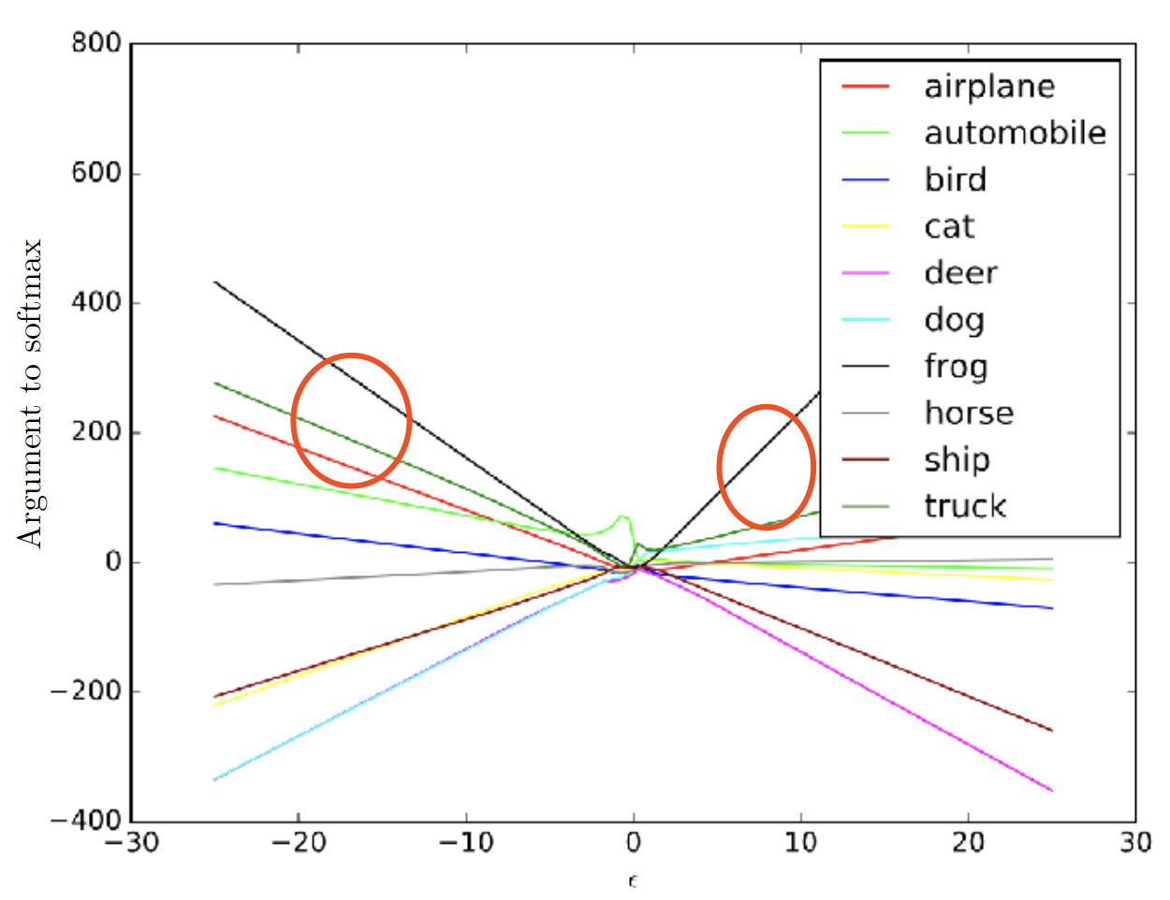
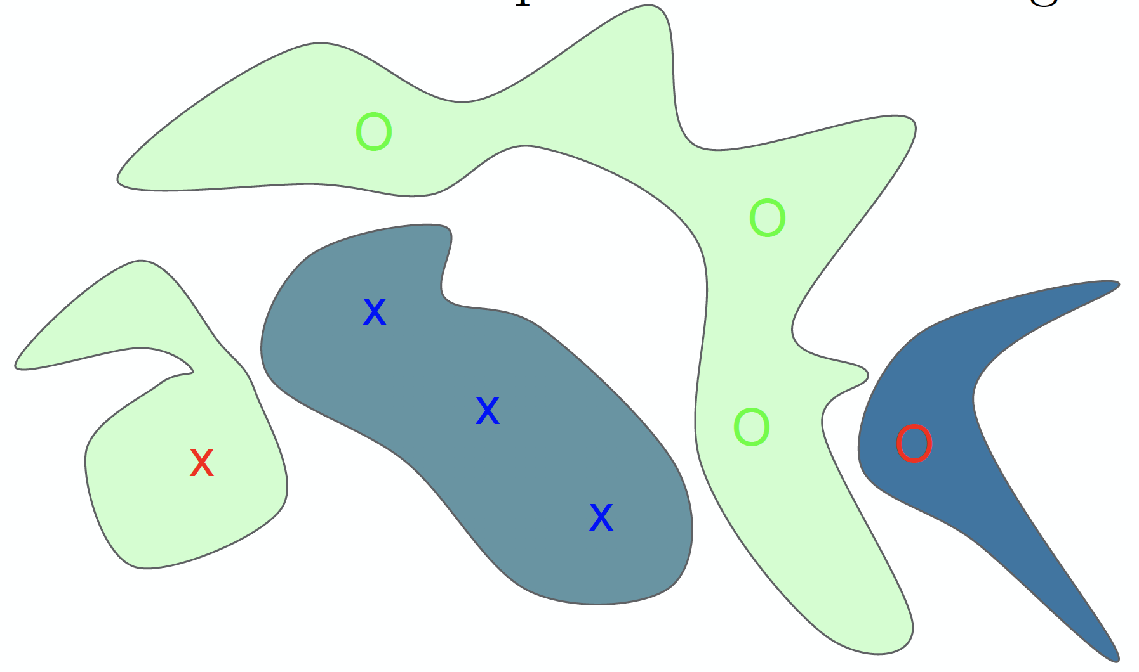
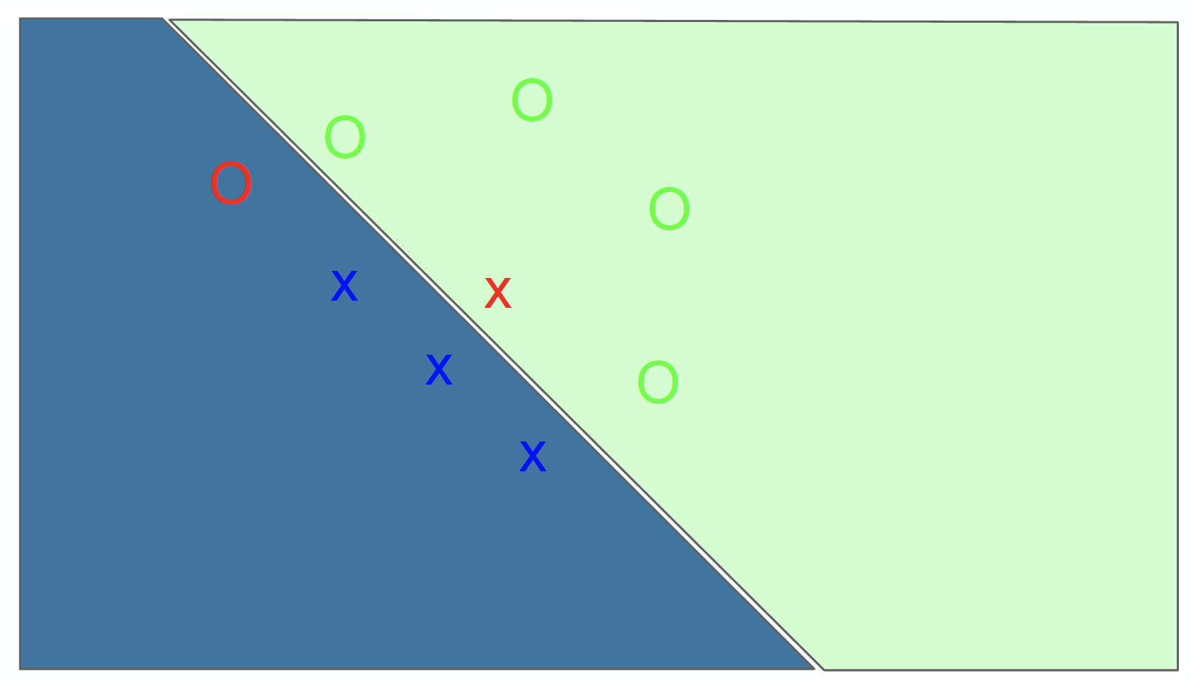

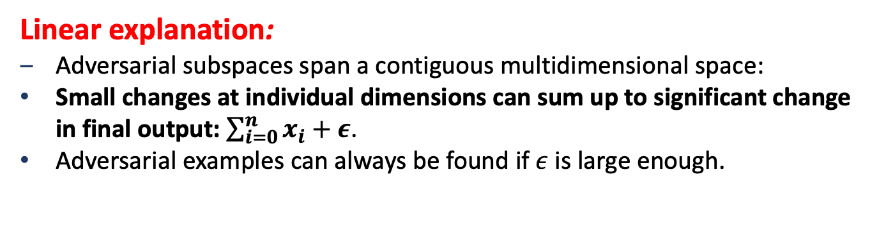
Linear Explanation
Viewing DNN as a stack of linear operations:
$$w^{T}x+b$$
Linear explanation:
Adversarial subspaces span a contiguous multidimensional space:
Small changes at individual dimensions can sum up to significant change in final output: $\sum_{i=0}^{n}{x_{i}+ε}$.
Adversarial examples can always be found if $ε$ is large enough.
Goodfellow I J, Shlens J, Szegedy C. Explaining and harnessing adversarial examples[J]. ICLR 2015.

Slide 42
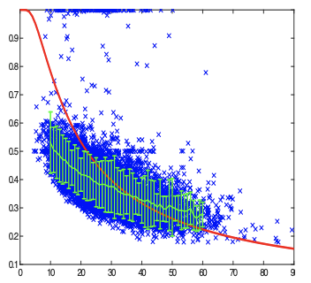
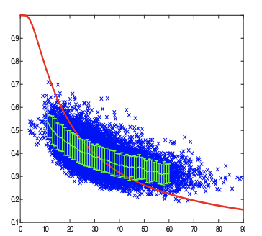
Vulnerability Increases with Intrinsic Dimensionality
ImageNet
CIFAR-10
Y-axis: the minimum adversarial noise required to subvert a KNN classifier
X-axis: LID values
Red curve: theoretical bound
Amsaleg et al. The Vulnerability of Learning to Adversarial Perturbation Increases with Intrinsic Dimensionality. WIFS, 2017

Slide 43
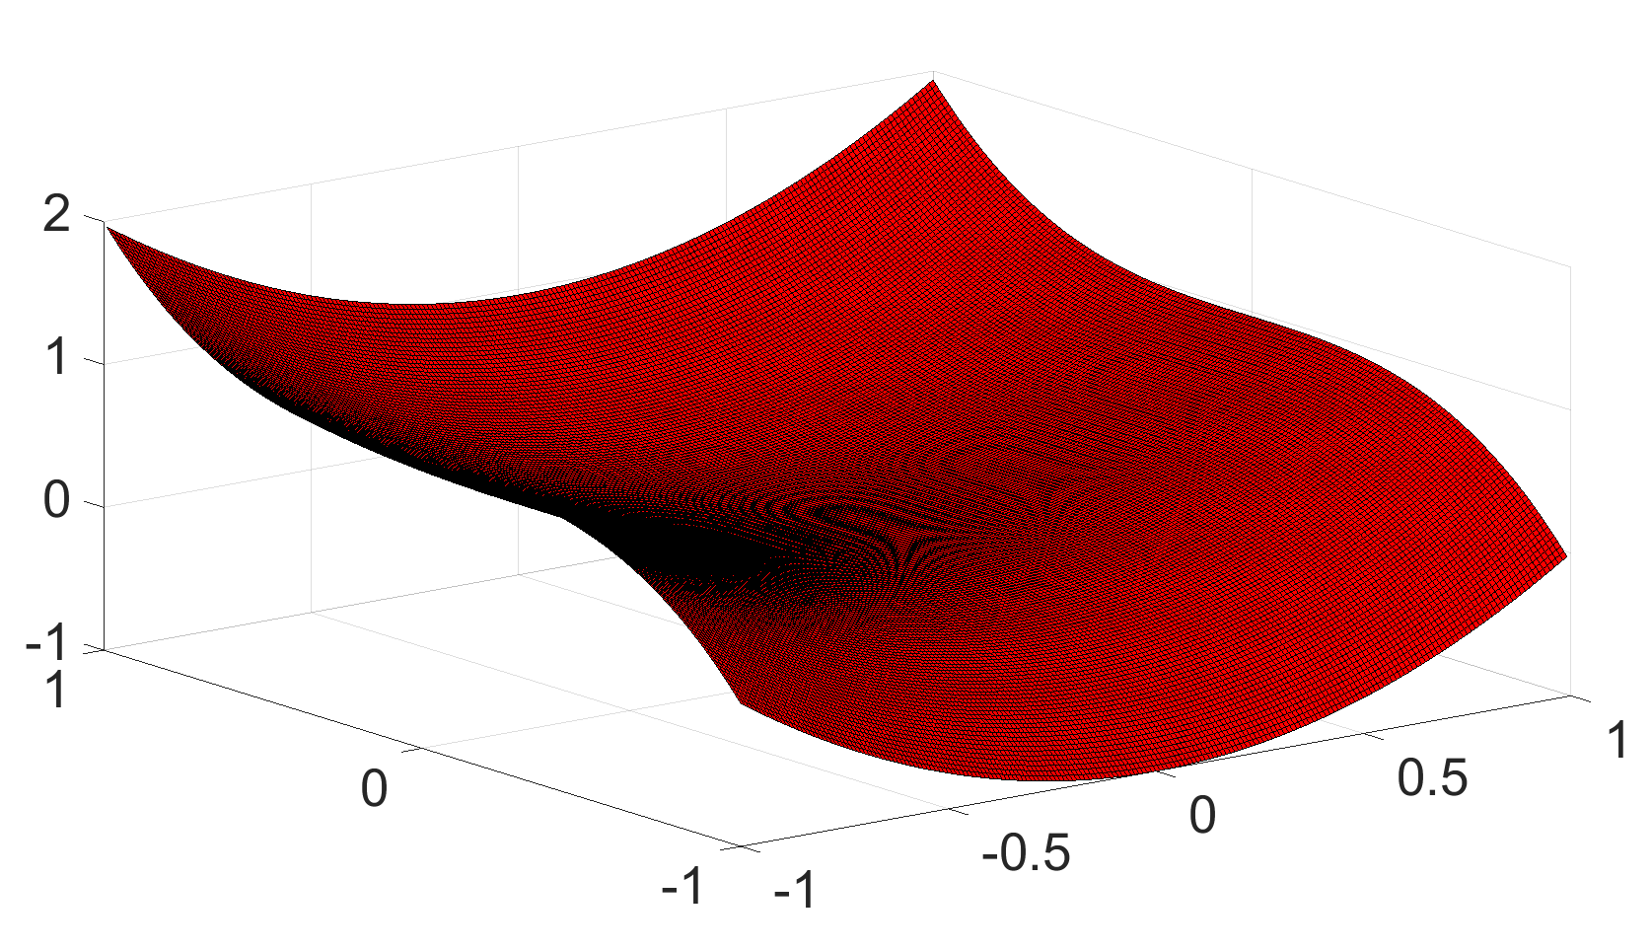
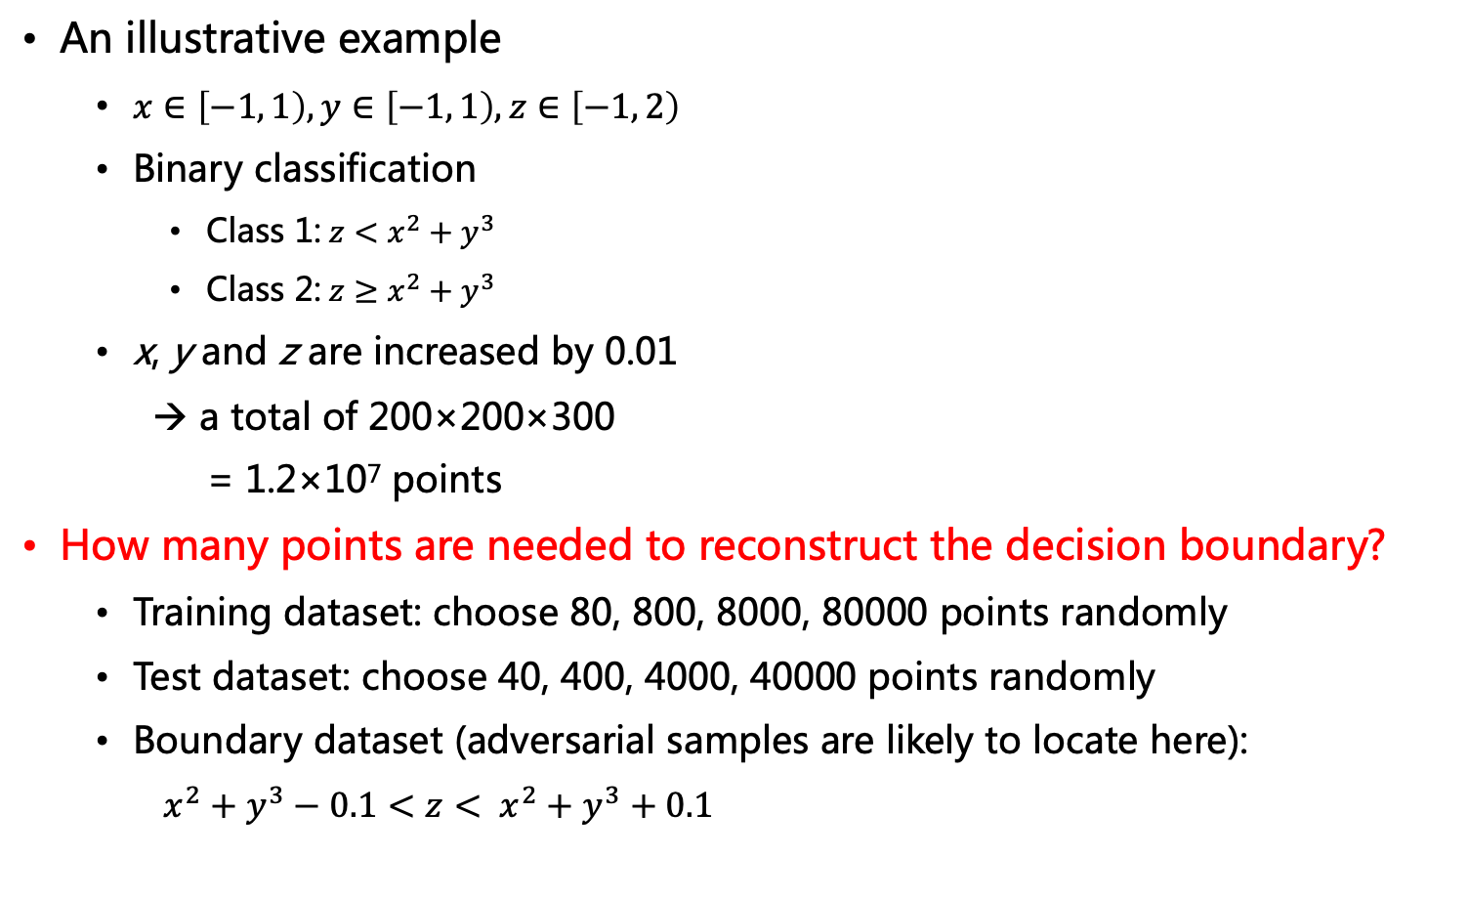
Insufficient Training Data
An illustrative example
$x∈\left[−1, 1\right),y∈\left[−1, 1\right), z∈\left[−1, 2\right)$
Binary classification
Class 1:$z<x^{2}+y^{3}$
Class 2:$z≥x^{2}+y^{3}$
x, y and z are increased by 0.01
→ a total of 200×200×300
= 1.2×10⁷ points
How many points are needed to reconstruct the decision boundary?
Training dataset: choose 80, 800, 8000, 80000 points randomly
Test dataset: choose 40, 400, 4000, 40000 points randomly
Boundary dataset (adversarial samples are likely to locate here):
$x^{2}+y^{3}−0.1<z< x^{2}+y^{3}+0.1$

Slide 44



Insufficient Training Data
Test result
RBF SVMs
Linear SVMs
8000: 0.067% of 1.2×10⁷
MNIST: 28×28 8-bit greyscale images, ${{(2}^{8})}^{28×28}≈1.1×{10}^{1888}$
$1.1×{10}^{1888}×0.067\%≫6×{10}^{5}$
Size of the training dataset | Accuracy on its own test dataset | Accuracy on the test dataset with 4×10⁴ points | Accuracy on the boundary dataset
80 | 100 | 92.7 | 60.8
800 | 99.0 | 97.4 | 74.9
8000 | 99.5 | 99.6 | 94.1
80000 | 99.9 | 99.9 | 98.9
Size of the training dataset | Accuracy on its own test dataset | Accuracy on the test dataset with 4×10⁴ points | Accuracy on the boundary dataset
80 | 100 | 96.3 | 70.1
800 | 99.8 | 99.0 | 85.7
8000 | 99.9 | 99.8 | 97.3
80000 | 99.98 | 99.98 | 99.5

Slide 45

Unnecessary Features
$f=g∘c$
$d$: similarity measure
Do machine learning models extract the same features as humans?
Wang et al. "A theoretical framework for robustness of (deep) classifiers against adversarial examples." arXiv:1612.00334 (2016).

Slide 46

Unnecessary Features
Adversarial samples can be far away from the original instance in the trained classifier’s feature space, and at the other side of the boundary
Each adversarial sample is close to the original instance in the oracle feature space
Unnecessary features ruin strong-robustness
If $f_{1}$ uses unnecessary features → not strong-robust
If $f_{1}$ misses necessary features used by $f_{2}$ → not accurate
If $f_{1}$ uses the same set of features as $f_{2}$→ strong-robust, can be accurate

Slide 47
Robust vs Non-robust Features
Predictive features of the data can be split into
Robust: Patterns that are predictive of the true label even when adversarially perturbed
Non-robust: Patterns that while predictive, can be flipped by an adversary within a pre-defined perturbation set to be indicate a wrong class.
Ilyas et al. Adversarial Examples Are Not Bugs, They Are Features. NeurIPS 2019

Slide 48
Robust vs Non-robust Features
Ilyas et al. Adversarial Examples Are Not Bugs, They Are Features. NeurIPS 2019

Slide 49
Robust vs Non-robust Features

Slide 50
Robust vs Non-robust Features
Training on original set, both the robust & non-robust features of the input are predictive of the label

Slide 51
Robust vs Non-robust Features

Slide 52
Robust vs Non-robust Features

Slide 53
Robust vs Non-robust Features
Training on perturbed set, only the non-robust features provide correct guidance for generalization
Ilyas et al. Adversarial Examples Are Not Bugs, They Are Features. NeurIPS 2019

Slide 54
谢谢！

